Slide 1

AAU TAEKWONDO
Officials Clinic

Slide 2
AAU TAEKWONDO
General Information About the AAU Program
Notes:
2

Slide 3

Is T-Rex’s Head Moving?

Slide 4
You can’t win an argument with a coach. The coach always thinks the way they see something is the only way it was and you will never convince them otherwise.

Slide 5
2018 Rule Changes
Rule Changes
Rule Change Proposals were discussed and accepted by the 2017
by the TRC on October 3, 2017.
As this was a non-convention year, the rules were ratified by the Executive Committee on October 10, 2017.

Slide 6
2018 Rule Changes
Many Minor Changes to Handbook
There were many minor changes made to the wording of many areas of the handbook. Some changes were changing a word “must” to “may. Other changes were clarifying in writing the way we are currently doing something.
Please take time to reread the entire handbook.

Slide 7
2018 Rule Changes
Policy Changes
Special Needs competition was moved from the Qualifying Events to Non-Qualifying Events. Mr. Friello, as tournament director for the National Championships, has made the decision to discontinue offering Special Needs competition at the Nationals due to lack of interest. It will still be offered locally at the discretion of the local tournament directors.
Sport Poomse will be added to the Non-Qualifying Events. Steps are being taken to try to include Sport Poomse in the 2018 competition year.
The division previously titled ‘Junior’ has been changed to ‘Youth’.
The division previously called ‘Ultra 43 and up’ has been removed. The Executive division is now for ages 33 and up.
AAU will now develop a Cadet, Junior, and Senior Point Sparring team. Team members will be the 1st place competitor in each of those categories at the National Championships.

Slide 8
2018 Rule Changes
Challenge Cards for Olympic Sparring
    When using non E-headgear, if there is a legal attack to the head area and no point is scored, any of the officials or coaches may ask for confirmation of the head kick.
    When using E-headgear, only the face may be challenged. If there is a legal attack to the face area and no point is scored, any of the officials or coaches may ask for confirmation of the ‘face kick’.
    The Referee shall gather the Judges to ask for statements. After discussion, the Referee will add the point if it is confirmed by the corner judges. If not confirmed by the corner judges, and if the challenge came from the coach, a challenge card will be taken away from the coach who challenged the kick.
    Challenge Cards. Coaches will be given two (2) challenge cards each, with the challenge card color being dependent on the fighter’s color (i.e. two blue challenge cards will be given to the blue player’s coach, and two red challenge cards will be given to the red player’s coach). These will be given at the beginning of each match to have the center referee pull the judges and question a head kick.
      If the red player’s coach loses his request, he will lose a red challenge card. If both challenge cards are lost, the coach is no longer allowed to question a head kick.
    If the match goes to a Golden Point round, the coaches will be permitted one (1) challenge card each.

Slide 9
2018 Rule Changes
IVR for Olympic Sparring
IVR – Instant Video Replay may be used locally or nationally at the tournament director’s discretion. Here are the rules governing IVR.
IVR may be requested for only one action which has occurred within the previous five (5) seconds.
A coach may only challenge
      The validity of attack to the head area for either contestant if Electronic headgear is not being utilized.
      The validity of technical point, if point scored by PSS or judges, for either contestant.
In the last 10 seconds of the last round and in any time during golden point round, any of the judges can ask for IVR review and correction of scoring when a coach does not have challenge card.
Referee may request IVR for head/face contact after a count as a result of a knockdown and no points scored by PSS headgear. If accepted points shall be awarded for valid kick.

Slide 10
2018 Rule Changes
Electronic Headgear
If Electronic Headgear is utilized, only points scored by the headgear shall be recorded automatically by the transmitter in the headgear.
If a technical point was given for a turning kick, but the kick was not scored by the PSS, the technical point shall be invalidated.
Judges shall score valid point(s) to the head area by a foot technique when electronic headgear is not utilized.

Slide 11
2018 Rule Changes
Olympic Sparring Rule Changes
This is the BIG change for Olympic Sparring.
All penalties are now Gam-jeom penalties.
The hand signal for a Gam-jeom penalty is now the hand signal previously used for Kyong-go penalties.

Slide 12
2018 Rule Changes
Olympic Sparring Rule Changes
Valid Scores for Olympic Sparring
One point for a valid hand attack to the legal scoring area of the trunk
  Two points for a valid foot attack to the legal scoring area of the trunk
  Three points for a valid turning kick to the legal scoring area of the trunk (continuous motion)
  Three points for a valid kick to the head
  Four points for a valid turning kick to the head (continuous motion)
  One point will be awarded a competitor for every gam-jeom infraction given to the opponent.

Slide 13
2018 Rule Changes
Olympic Sparring Rule Changes
Changes Impacted with Elimination of Kyong-go Penalties
Compliance
If a competitor, upon being called to the center of the ring to compete, is found in violation of Articles I and/or II (Protective Equipment and Personal Requirements) that competitor will receive one minute to come into compliance. If within that one minute the competitor returns to the center ready to compete, he/she will receive a gam-jeom and the match will begin. If he/she does not return to the center ready to compete at the end of one minute an additional one-minute count down will begin. If that competitor returns to the center within the second one-minute period, then the competitor will receive a second gam-jeom and the match will begin. If the competitor does not return within the total two-minute grace period, that competitor may be disqualified.

Slide 14
2018 Rule Changes
Olympic Sparring Rule Changes
Changes Impacted with Elimination of Kyong-go Penalties
Golden Point Round and Rules of Superiority
In the event the score is tied a “Golden Point” round of one (1) minute duration will follow. The score and penalties will be reset to zero for the Golden Point round. The competitors will be directed back to their coaches’ seat for the normal rest period between rounds. The first contestant to score a point(s) or whose opponent received two (2) gam-jeoms in the Golden Point round shall be declared the winner.
If not using PSS, the Referee and Corner Judges will use the normal superiority method based on the Golden Point round to determine the winner. On the Referee’s woo-si-girok command, Corner Judges will record a vote using paper to indicate their decision for the winner.

Slide 15
2018 Rule Changes
Olympic Sparring Rule Changes
Changes Impacted with Elimination of Kyong-go Penalties
Golden Point Round and Rules of Superiority
If the match is still not decided after the Golden Point round, and the competitors are using PSS equipment, the winner will be determined as follows:
The first criteria will be the competitor who makes the most contact to the other competitor's chest protector in the Golden Point round as scored by PSS (the hit level does not matter). **Note: If a point scored from an illegal act and the referee invalidates the point, giving a gam-jeom, the TL must eliminate the missed hit immediately from the scored hits.
If the score is still tied (same number of hits), the competitor who receives the least gam-jeoms from all rounds will be the winner.
If the first two criteria are tied, the Referee and Corner Judges will use the normal superiority method based on the Golden Point round to determine the winner. On the Referee’s woo-si-girok command, Corner Judges will record a vote (using paper, controllers or hand signal) to indicate their decision for the winner.

Slide 16
2018 Rule Changes
Olympic Sparring Rule Changes
Changes Impacted with Elimination of Kyong-go Penalties
Punitive Declaration
If a competitor accumulates ten (10) gam-jeom penalties, the Referee will declare him/her the loser by punitive declaration.
Joo-eui Warnings
Joo-eui warnings can now be given for Gam-Jeom penalties with the same restrictions of one per person, per infraction, per round.

Slide 17
2018 Rule Changes
Olympic Sparring Rule Changes
Match Times
Colored Belt Rounds
All colored belt matches shall consist of two 90-second rounds with a 30-second rest between rounds.
Black Belt Rounds: AAU Team Trials and/or National Championship matches
  Youth (5-9), Mini-Cadet (10-11), Cadet (12-14) and Executive (33 and up) shall compete using three one-minute rounds with a 30-second rest
  Junior (15-17) Shall compete using three 90-second rounds with a 30second rest
  Senior (18-32) Shall compete using three two-minute rounds with a 60second rest
For District and Regional competition, the tournament Directors have the option of using the times outlined above or using two two-minute rounds with a 30-second rest between rounds for Black Belts. Match times being used at local events must be specified on tournament flyer.

Slide 18
Coach and Officials Certification Fees
Coach
Official
Anyone wishing to coach at any AAU sanctioned event will be required to complete the online coaches certification and pay the $50 online clinic fee.
Anyone wishing to only officiate at any AAU sanctioned event will be required to take a local official’s certification clinic and pay the $35 clinic fee.
Both
Anyone wishing to both coach and officiate at any AAU sanctioned event will be required to both take the online clinic to obtain coach’s certification and attend a local official’s clinic to obtain official’s certification.

Slide 19
Official’s Upgrade Process
Class E
Class D
Refers to Court Officials (scorekeepers, computer operators, etc.) at District, Regional and National levels. Class E officials may, if needed, corner judge non-Black Belt divisions at Regional or District level only.
Basic understanding of official rules and procedures
Working knowledge of time keeping and score keeping
Minimum age requirement of 14
No rank requirement
Yearly attendance of a District/Regional Clinic Workshop
Anyone who is in the system as an E will automatically be upgraded when the required age and/or belt is reached
  Refers to Judges at District, Regional or National competitions. D officials may, if needed or if being evaluated for upgrade, center for non-black belt divisions only.
  Understanding of official rules and procedures
  Understanding judge responsibilities at district or regional levels
  Working knowledge of charting time keeping and score keeping
  Minimum age of 15
  Minimum rank of Red/Brown Belt
  Must attend a yearly district/regional clinic

Slide 20
Official’s Upgrade Process
Class C
Class B
Class C officials may, if needed or if being evaluated for upgrade, center referee at National competitions for non-Black Belt divisions only
Must have officiated as a corner judge as a D level official for a minimum of 2 local or regional AAU sanctioned events or one AAU sanctioned National event.
Minimum age of 16.
Minimum rank of 1st Dan Black Belt
Must attend a yearly District/Regional Clinic & Workshop.
Must request to be evaluated for an upgrade at either the local, regional or national level. Request for upgrade at the local level should be made to the tournament director who will supply a list of applicants to the tournament Head Referee.
  Must have been a class C official for a minimum two years.
  Minimum age of 18.
  Must attend a yearly District/Regional Clinic & workshop.
  Must request to be evaluated at the AAU National Championships when registering for the event.
  Must pass written test and practical evaluation by a combined score of 80%.
  Must be evaluated on performance as a judge and referee for forms and sparring competition. To be eligible for evaluation, candidates must work a minimum of three full days during the Nationals Championship
  Must work six AAU Sanctioned events as a C official

Slide 21
Official’s Upgrade Process
Class A
Class AA
  Must have been a class B official for a minimum three years.
  Must attend a yearly District/Regional Clinic & workshop.
  Must officiate at three National Championships as a B official.
  Must request to be evaluated at the AAU National Championships when registering for the event.
  Must pass the written test and practical evaluation by a combined score of 85%.
    Candidate must work a minimum of four full days during the Nationals Championship event.
  Must work 15 AAU Licensed events as a B official.
  Must have been a class A official for a minimum five years.
  Must attend a yearly District/Regional Clinic & workshop.
  Must officiate at five National Championships as an A official.
  Must request to be evaluated at the AAU National Championships when registering for the event.
  Must pass the written test and practical evaluation by a combined score of 90%.
    Candidate will be evaluated on performance as a judge and referee for forms and sparring competition. To be eligible for evaluation, candidate must work all five full days of the Nationals Championship event.
  Must work 40 AAU licensed events as an A official

Slide 22
Maintaining Official’s Classification
Maintaining Your Classification
All officials holding a classification of B or higher will be required to participate as an official in some capacity at a minimum of one national event within a two-year period to maintain their current status.
  Not meeting this requirement may result in a downgrade in status of one level every two years, not to be lowered past C level official.
The total number of required work days must be worked at the same event. (that is, an official cannot split the required work days between multiple events or years).
Participation within a two-year period at the AAU National Championships would be as follows:
  AA officials must work 5 days
  A officials must work 4 days
  B officials must work 3 days
Participation within a two-year period at the AAU J.O. Games would be as follows:
  Only B officials may use the J.O. Games to maintain their classification
  B officials must work the entire event, including weigh-ins if requested, if not working Nationals and needing the J.O. Games to maintain their classification

Slide 23
General AAU TKD Competition Guidelines

Slide 24
Types of Competition
Qualifying Events
    Forms
    Point Sparring
    Olympic Sparring

Slide 25
Types of Competition
Non-Qualifying, Optional Events
Team Forms | Sport Poomse | Seven Categories of Board Breaking | Creative Forms | Weapons Forms | Padded Weapons Sparring
Demo Team Competition |  | Self Defense | Creative Musical Forms | Musical Weapons Forms | Special Needs
    Rules governing Team Forms competition are outlined in the AAU competition rules as posted on www.aautaekwondo.org.
    Rules governing Board Breaking and Creative forms will be established by the individual tournament director and supplied in the event package for that event.
    Qualifying is not required for Special Needs competitors

Slide 26
Division Categories
Age Categories
Belt Categories
Youth Ages 5 – 17
Senior Ages 18 – 32
Executive Ages 33 and Up
Athletes may not compete in more than one category.
The age of the competitor on December 31st determines the age of competitor for the entire year.
Novice White, Yellow, Orange
Intermediate Green, Blue, Purple
Advanced Brown, Red
Black Black
Competitors must compete at their rank on the day of the event.

Slide 27
Officials

Slide 28
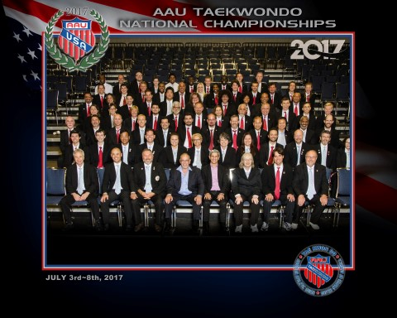
2017 AAU National Championship Officials

Slide 29
Officials
Code of Conduct
Attire
As an AAU Referee, I understand that I am an ambassador of AAU TKD, in and out of competitions. I will conduct myself in an exemplary manner at all times.
I will uphold my integrity as an AAU Referee and remain free of any possible conflicts of interest. I will uphold the integrity of AAU competition and protect the spirit of TKD.
I will act in a manner consistent with the spirit of fair play and the TKD Movement.
I will not commit any behaviors that will bring disgrace to AAU TKD, such as receiving gift or other valuables in connection with passing a judgment in favor of an athlete.
Black Slacks
White, collared shirt (long or short sleeve)
    No sleeveless shirts
Official AAU tie
Black blazer
White, Black or Black & White sneakers
Black socks

Slide 30
Officials Protocol
Do’s
Don’ts
Judges wear jackets. Referees do not
      (If it is warm, everyone can remove their jackets, but all judges must be consistent. If one judge has jacket off, all must)
Officials (Center) should remove watches and jewelry
Judges should sit with both feet on the floor
A judge can stand to get a better view
A judge should focus only on their match
Officials should conduct themselves appropriately at all times
Officials should avoid giving the appearance of favoritism by cheering for students competing in and outside of their ring.
Officials should not use cell phones while in the competition area.
Officials should avoid any confrontation with athletes, parents or coaches.

Slide 31
Coaches
Notes:
31

Slide 32
Coaches Attire
Do’s
Don’ts
White dobok pants or warm-up pants (stripes are allowed)
  Warm-up pants or any color warm-up pants
Official blue AAU coach’s shirt (must be official AAU shirt)
    Coaches shall remove warm-up tops or any article of clothing that covers the blue coach shirt prior to sitting in the coaches chair
Sneakers (any color is okay, but must be sneakers)
No shorts or blue jeans
Coaches shall not wear hats on the competition floor
Coaches shall not use video cameras, walkie-talkies, cell phones, ear phones, etc while on the competition floor

Slide 33
Coaches Protocol
Do’s
Don'ts
Coach and athlete are responsible for picking up credentials from head table after completion of the match or division
Coaches must remain seated during the match
Coaches shall direct comments to their own player only
Comments considered to be directed towards the officials which are intended to either influence their decision or protest scores and penalties will result in penalties being issued.
Coaches words or actions deemed to be abusive or inappropriate towards other players, officials or their own player will not be tolerated and shall be removed from the tournament.

Slide 34
Athletes
Notes:
34

Slide 35
Athlete’s Attire
Clean white dobok.
Black trim allowed for Black Belts only.
A t-shirt and/or sports bra may be worn underneath the dobok.
Sleeves and cuffs cannot be rolled up.
Sleeves and cuff must be no higher than ½ distance between wrist and elbow or ankle and knee.
Jacket may not be tucked into pants.
Uniform must be neatly hemmed.

Slide 36
Athletes Attire
All competitors must wear a belt appropriate to their rank.
Youth black belts (15 years of age and younger) are permitted to wear Poom belts as well as Poom collars. (half-red, half black)
If your belt system does not follow the AAU TKD configuration, be sure your athlete, and parent, understands where their belt fits into the AAU TKD system and is wearing the appropriately equivalent AAU color belt for competition

Slide 37
AAU TKD
Forms Competition Rules
Notes:
37

Slide 38
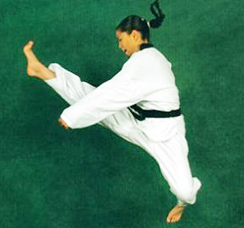
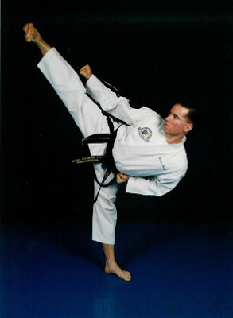
Individual Forms/Poomse/Patterns

Slide 39
Criteria for Judging Patterns
Beauty – appeal
Grace – balance, flow
Rhythm – tempo, timing
Focus – aim, concentration
Power – stances, blocks, kicks & strikes
Technique – kicks, blocks, strikes, etc. executed correctly
Be aware that there are different styles in AAU program. Each style has a different concept of what the forms are supposed to represent and how they are performed
  Power stances vs. walking stances
  Chambered position of recoil hand
  Speed. This is not a criteria for scoring and in itself should not be considered unless it effects the rhythm of the form or the effectiveness of the technique.
  Consistency of techniques. If the competitor is performing the form as they were taught, the techniques will be the same on both sides.
Notes:
December 2004
39

Slide 40
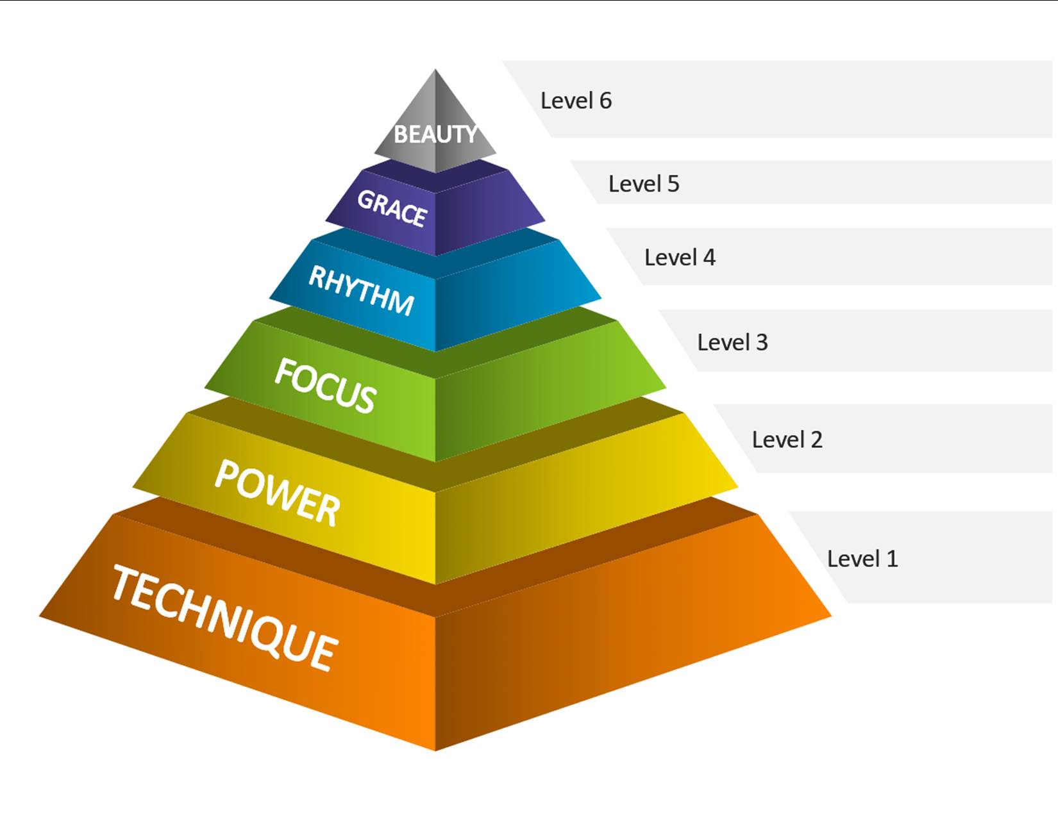
Forms Pyramid
The base of a pyramid is most important. Without a good base the rest won't stand up.
Technique is the base and should be considered first and foremost. Then go up the pyramid to determine the quality of the pattern.
Notes:
December 2004
40

Slide 41
Forms Competition Rules
Forms competition can be conducted either as scored or bracketed competition.
The tournament director reserves the right to decide which type of competition will be used.
Youth Forms Divisions of 40 or more will be divided into two age groups.
Currently National competitions use the bracketed forms method of competition with Brazilian Repechage type bracket system (explained later).
Notes:
41

Slide 42
Methods of Scoring
Forms can be judged using either a scored method or a bracketed method. Most AAU tournaments have adopted the bracketed method of scoring, however, the scored method is always used for special needs forms competition.
For more information on the rules that govern scored forms, refer to the AAU Taekwondo Handbook.
Notes:
42

Slide 43
Bracketed Forms
Types of Brackets
There are numerous types of bracketing systems that can be used when conducting bracketed competition. Here are a few used in AAU competitions.
  Single Elimination – Used for most sparring competitions
  Brazilian Repechage - Currently used at AAU National any most local competitions for forms competition (Will be explained in detail later)
  Round Robin (Currently used at Team Trials)
Notes:
43

Slide 44
Bracketed Forms
Competition Rules
Competitor names and the validity of the form for their rank will be checked by the Referee prior to competition.
Two competitors will present their form simultaneously.
No competitor may begin a form a 2nd time unless both competitors are unable to complete the form the first time.
The competitors are called into the ring and instructed to bow to each other as in sparring competition.
Notes:
44

Slide 45
Bracketed Forms
Competition Rules
The Referee will have the competitors face forward and will then announce Shi-jak.
The Referee will exit the back of the ring and stand where Chung enters the ring
When the competitors have completed their forms, the Referee will enter the ring, call them to their marks, and bow them out, call for score and award the win. Do not turn to face the head table.
Notes:
45

Slide 46
Bracketed Forms
Competition Rules
When using three Judges (Referee not judging), the Referee will command “Judges, Call” while holding both arms parallel to the floor, palms down and fingertips touching. The judges will cast their vote through the use of flags.
If a Judge thinks a form has been modified, he/she should stand up prior to the Referee announcing “Judges, Score”.
The Referee will award the win by dropping both hands to his/her side, then raising either the right hand for Chung or the left hand for Hong with a closed fist to the sternum, continuing at a 45-degree angle with the palm facing upward and declare the winner.
Notes:
46

Slide 47
Bracketed Forms
Position of Judges
Bracketed forms competitions are usually conducted with one Referee and three Judges.
The Referee does not vote.
The Judges are positioned in an equilateral triangle, one on each front corner and one between the two back corners.
The judges should always use flags to vote as the it is easier for the spectators to see how the votes were cast.
Notes:
47

Slide 48
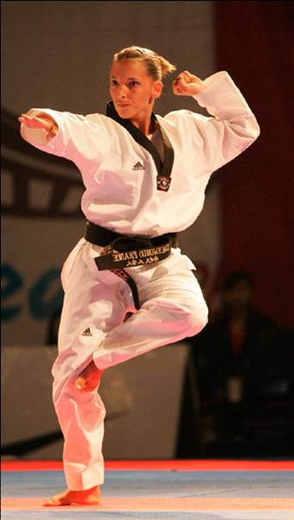
When Has a Form Been Altered?
Wrong block, i.e. outside block instead of inside block is not criteria. If the modification does not change the integrity of the form or cause a change to it’s overall value it should be overlooked.
Form modification is your decision that a form has been altered or modified in such a way as to impact the score of the form.
Notes:
December 2004
48

Slide 49
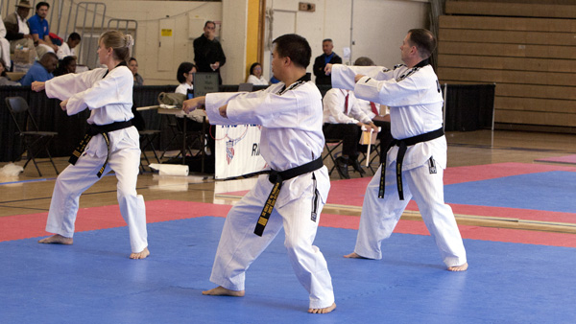
Team Forms
Team consists of 3 members
All team members must be Black Belts
An individual can compete on only one team
Team should consist of 5-17 year olds or 18 year old and up
Same rules apply to team forms as to individual forms except that the team can present a form up to the level of the highest ranking member of the team
Entrance decorum must be consistent with individual forms entrance
Notes:
December 2004
49

Slide 50
Brazilian Repechage Bracketing System
Brazilian Repechage bracketing allows for the person who is the true 2nd place competitor to claim 2nd place even if they lost to the 1st place competitor in one of the first rounds. The top portion of the Repechage bracket must be completed prior to beginning the bottom portion. In Brazilian Repechage, the top portion of the bracket determines only the 1st place competitor in the division. The bottom portion of the bracket decides who will compete against the loser of the top bracket for 2nd and 3rd place.
Notes:
50

Slide 51
Brazilian Repechage Example
16 Player Bracket
Notes:
51

Slide 52
Brazilian Repechage Example
4 Player Bracket
Notes:
52

Slide 53
General Rules Applying to Both Point and Olympic Style Sparring

Slide 54
Athlete Compliance
If a competitor, upon being called to the center of the ring to compete in point or Olympic sparring, is found to be in violation of any equipment or personal requirements, the competitor will be given one minute to come into compliance. If, within one minute, they are ready to compete, he/she will receive a kyong-go (in Point) or Gam-Jeom (in Olympic) penalty and the match will begin.
If the competitor cannot comply within one minute, they will be given an additional one minute. If they are ready at the end of the second minute, they will receive a gam-jeom penalty (in Point) or a 2nd Gam-Jeom (in Olympic) and the match will begin.
If the competitor cannot comply within two minutes, they may be disqualified.

Slide 55
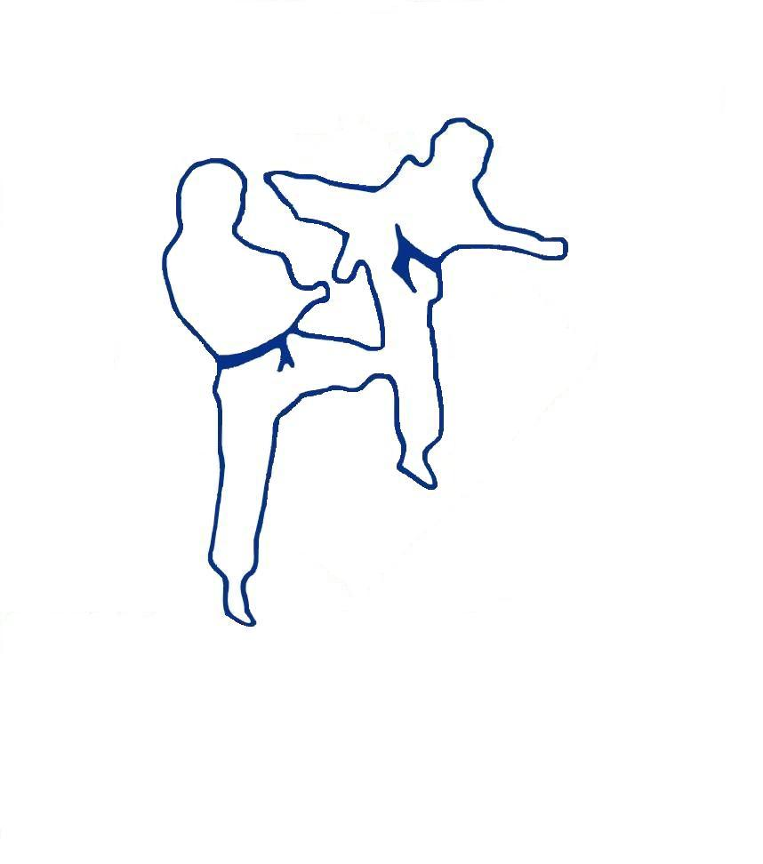
Point
Sparring
Rules
Notes:
55

Slide 56
Athlete’s Gear – Point Sparring
Mandatory Equipment
Optional Equipment
Mouth-guard
Full hand protectors – any color. Must be foam dipped/vinyl only.
Full foot protectors – any color. Must be foam dipped/vinyl only.
Full headgear – any color. Must be foam dipped/vinyl only. Headgear that includes padding under and around the chin, is not allowed. Other than for religious reasons, nothing else can be worn on the head but the headgear.
Male competitors must wear groin cup and supporter on inside of dobok
Safety equipment must not be taped for any reason
Cloth or foam shin, shin/instep protectors
Cloth or foam forearm protectors
Foam dipped/vinyl rib protectors
Sport eyeglasses will be allowed, but soft contacts are highly recommended.
Clear plastic face shield
All optional equipment must be worn under the dobok with the exception of the face shield
Notes:
December 2004
56

Slide 57
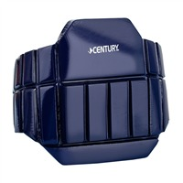
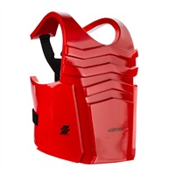
Athlete’s Gear – Point Sparring
Accepted Optional Equipment
Not Accepted Optional Equipment
Notes:
December 2004
57

Slide 58
Judges for Point Sparring
Position
Scoring
Point sparring competition will be conducted with one referee and three judges
The three judges are positioned in equilateral triangle with two judges on each front corner and one in the center of the two back corners
If there are not enough officials to run one referee and three judges, the competition can be run with one referee and two judges
If using one Referee and three judges, the Referee will not vote on points
If using one Referee and two judges, the Referee will vote
When using one Referee and three judges, point is called by using flags.
Any judge who sees a point must kihap and extend their flag.
Duration of Contest
All colored belt matches will be two (2) 90-second rounds with a 30-second rest
All Black belt matches will be two 2 minute rounds with a 30-second rest
If combined, matches will use Black belt match times
Competitors will be allowed a full 2 minute rest between semi-final and final matches

Slide 59
Scoring for Point Sparring
Valid Score
Implement
In order to score, the legal scoring implement must make contact to the legal target area and must be delivered with balance.
For head techniques to be awarded a point(s), the contact must be light.
Contact to the legal scoring area of the body should be light to moderate.
Half on/half off a legal scoring area of the body or head should be scored as a valid technique.
The hand: closed fist (fore-fist & back-fist) and ridge-hand.
  All other hand techniques will be considered unauthorized and the proper penalty will be assessed.
The foot: Any part of the foot below the ankle.
Scoring Area
Anywhere on the headgear.
The area of the body from the collarbone to the naval and down the side from center of armpit
Notes:
December 2004
59

Slide 60
Awarding Points for Point Sparring
The clock is not stopped to award points.
When called upon, each judge will flip his/her flag for the competition who scored, and simultaneously raise 1, 2, or 3 fingers of the other hand to indicate the points scored
After confirming that a point/points have been scored, the Referee will, using the index finger of the hand closest to the scoring competitor, announce the player’s color. He/she will then turn to the computer operator and announce the point(s) being awarded, either Il-Jeom, Ee-Jeom or Sam-Jeom.
One (1) point will be awarded for valid hand technique to a legal head or body area
Two (2) points will be awarded for valid foot technique to a legal body area
Three (3) points will be awarded for valid foot technique to legal head area
  In order to score, majority of judges must see point, must be executed with good balance, and must touch target area
Point Gap Rule for Point Sparring
The gap for point sparring is twelve (12) points
All competitors are guaranteed the 1st round of competition regardless of the point gap. At the end of the 1st round if a twelve point gap exists, the match is over. If not, the 2nd round will begin. Any time during the 2nd round if a twelve point gap occurs, the match is over.
Notes:
December 2004
60

Slide 61
Points for Point Sparring
A majority of the officials must concur for a point(s) to be awarded.
Examples of majority calls
Points awarded will be the highest number agreed upon by 2 or more judges. Example: judge 1 calls for 2 points blue and judge 2 calls for 3 points blue; both judges are calling for a minimum of 2 points blue, therefore 2 points will be awarded to blue.
At least two officials must see the same competitor score. If two Officials call for either one or two points for the blue competitor and one calls for one or two points for the red competitor, the blue competitor will be awarded the point(s).
Notes:
December 2004
61

Slide 62
Technique Off Balance
If a majority of the Judges ki-hap and extend their flags, the Referee must announce “Judges Call”. The point must be awarded if the majority of the Judges call the point. The Referee cannot wave off an ‘off balanced’ technique. This judgment is made by each Judge individually.
Being off balanced after throwing the technique does not necessarily mean the technique is considered off balanced. The act of controlling the kick or the action of the opponent can cause the player executing the technique to lose balance after delivering the kick.
Calling Points
ALL judges should ki-hap and extend their flag chest level and parallel to the floor when they see a technique meeting the requirements to be scored.
If a judge saw a one, two or three point technique, he/she will score by raising the flag for the color that scored and simultaneously extend the other hand in the air displaying 1, 2 or 3 fingers on the Referee’s ‘call’ command.
Judges should always use flags to indicate scoring so audience can plainly see the outcome of the call.
Notes:
December 2004
62

Slide 63
Infractions for Point Sparring
How Infractions Effect the Score
Any odd half-point infraction is treated as if it does not exist until there’s another half-point infraction.
Two half-point infractions total to a 1 penalty point which is recorded as one point for the opponent.
If the match is tied at the end of regulation time, all points and penalties are discarded and the overtime match starts with zero.
The winner is the first person to accumulate one full point change in score. There is no time limit for the overtime round.
Warnings
  Joo-eui (Verbal Warning Only - no hand signal)
    Only one joo-eui per Kyong-go infraction, per round, per competitor is allowed.
    A Kyong-go must be given if an athlete repeats the same offense during the same round.
    A Joo-eui penalty can only be given for Kyong-go offenses.
    A joo-eui warning is given at the point of the infraction.
    Since Joo-euis are not mandatory, they should be given sparingly in the final round to avoid a competitor using them to run out the clock.
Notes:
December 2004
63

Slide 64
Types of Penalties for Point Sparring
  Kyong-Go (1/2 Point Penalty)
      Kyong-Go penalties are all given at the point of infraction.
      A Kyong-Go penalty has no value until another Kyong-go penalty occurs. Then the two Kyong-Gos add together to make one full penalty point which is recorded as one point for the opponent.
  Gam-jeom (One Point Penalty)
      Gam-jeom penalties are all given at the point of infraction.
      All Gam-jeom penalties are recorded by adding one point to the opponents score.
      All penalties are noted on the scoreboard.
Notes:
December 2004
64

Slide 65
Kyong-go (Half-Point Infraction) for Point Sparring
  Evading by turning one’s back to the opponent
    It is OK to set up for a counter attack
    More than two steps moving away is ‘escaping’
    No intention of fighting
  Intentionally falling down
    Slipping or tripping do not count as a penalties
  Avoiding the match
  Grabbing, Holding, or Pushing the opponent
    Using either open hands or closed fists, when the athlete is displacing his opponent’s balance in order to gain an advantage it is a penalty
Pretending injury
Notes:
December 2004
65

Slide 66
Kyong-go (Half-Point Infraction) for Point Sparring
Crossing the boundary line with both feet
    When both feet go out, a penalty should be issued.
    A competitor being kicked out of the ring will be given a Kyong-go penalty.
Uttering undesirable remarks or misconduct
    Can be either the coach or the player
    Leaving the designated area
    Making disparaging remarks about the other athlete or coach
Making contact with an unauthorized implement
  Hammer Fists
  Pawing
  Flailing (two or more attacks with the same hand) to a legal head area
Notes:
December 2004
66

Slide 67
Gam-jeom (Full-Point Infraction) for Point Sparring
Attacking the opponent after the referee’s kalyeo command
Throwing the opponent by grappling the opponent’s attacking foot in the air with the arm or by pushing the opponent with the hand.
Making non-incidental contact to an unauthorized area
  A direct kick to a non-target area is a full point penalty
Excessive contact (Referee can make this call alone or with consultation with TL)
  Could also be DQ
Notes:
December 2004
67

Slide 68
Gam-jeom (Full-Point Infraction) for Point Sparring
Interrupting the progress of the match on the part of the contestant or coach
Attacking a fallen opponent
  A contestant is considered ‘fallen’ when any part of the body other than the feet touch the floor.
  Center needs to get in between the players when player begins to fall
Uncontrolled attack (The attack must make contact)
Violent or extreme remarks or behavior on the part of the contestant or coach
Notes:
December 2004
68

Slide 69
Disqualifications for Point Sparring
  Injuring the opponent’s face or neck
  Injuring the opponent by a malicious or excessive attack
    The referee with or without the consensus of the Team Leader
    shall determine if the attack was malicious or excessive
  Injuring and/or rendering an opponent unable to continue by using an unauthorized attacking implement or by attack to an unauthorized area
  Significant unsportsmanlike conduct on the part of the contestant or coach
  Accumulation of four minus points
Notes:
December 2004
69

Slide 70
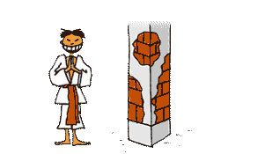

Time for Intermission

Slide 71
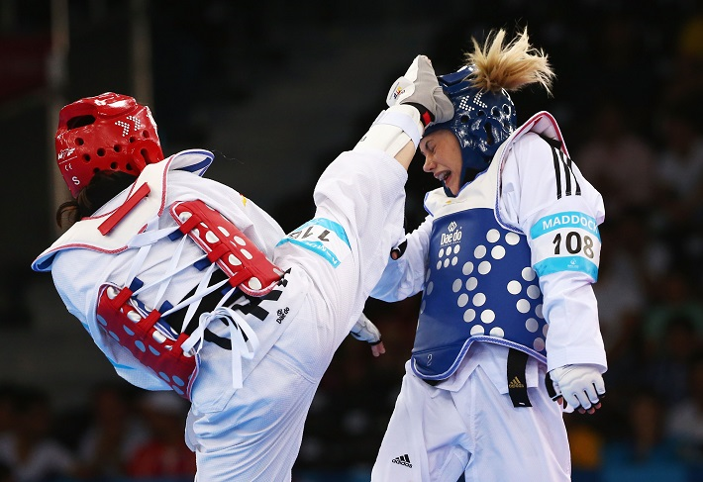
Olympic Sparring
Notes:
71

Slide 72
Mandatory Equipment for Olympic Sparring
Non PSS
PSS
Mouthguard
Olympic style chest protector (must fit)
Full headgear
  Red player must wear red headgear
  Blue player must wear blue headgear
  Nothing should be worn on head other than headgear except for religious reasons. If religious apparel is worn, it must be beneath the headgear and hogu. Hair must be tucked into the headgear including ponytails
Manufactured shin & instep protectors (white only & must be worn under dobok). WT socks are allowed instead of, but not combined with, instep protectors.
Forearm protectors (white only and must be worn under dobok)
  Optional: WT approved white gloves can be worn.
Male competitors must wear groin cup and supporter on inside of the dobok
Mouthguard
KP&P Hogu-Size determined by KP&P weight division requirements
Full headgear (Electronic or non-electronic)
  Red player must wear red headgear
  Blue player must wear blue headgear
  Nothing should be worn on head other than headgear except for religious reasons. If religious apparel is worn, it must be beneath the headgear and hogu. Hair must be tucked into the headgear including ponytails
KP&P sensing socks
Shin protectors (white only, no instep, and must be worn underneath the dobok)
Forearm protectors (white only and must be worn under dobok)
WT approved white gloves
Male competitors must wear groin cup and supporter on inside of the dobok
Notes:
December 2004
72

Slide 73
Personal Requirements for Olympic Sparring Competitors
No metallic articles, including wedding bands, are allowed.
  Metal articles cannot be covered or taped
Eyeglasses of any kind are not allowed
Fingernails and toenails must be trimmed short
Uniforms must be clean and in good condition
The use of drugs, alcohol, stimulants or injections in any part of the body, either before or during a match, is absolutely prohibited.
Any competitor whose hair, in the opinion of the Referee, is so long that there could be a risk of causing inconvenience or injury to themselves or opposing player, will be required to tie it back securely and could be required tuck it inside the headgear or uniform.
Medical Tape
A maximum of three layers of tape are allowed except in the case of an injury
For an injury, the minimum amount of tape that will protect the area should be used and approved by the tournament physician
Under no circumstances will a hard splint or cast be allowed
Pre-wrap is limited to one layer under tape
Notes:
December 2004
73

Slide 74
Position of Judges for Olympic Sparring
AAU conducts Olympic sparring competition with one referee and three judges
Judge #1 sits to the left of the head table on the corner
Judge #2 sits between the two back corners
Judge #3 sits to the right of the head table on the corner
These positions are important to know so the TL and Referee can monitor the judges scoring or notice if one or more controllers may not be working.
Point Gap Rules for Olympic Sparring
The point gap for Olympic Sparring is 20 points.
Any Olympic sparring division using two rounds will be guaranteed the first round regardless of the gap. If there is a 20 point gap at the end of the 1st round, the match is over. If there is not a 20 point gap at the end of the 1st round, the 2nd round will begin. If a gap occurs at any time in the 2nd round, the match is over.
Any Olympic division using three rounds will be guaranteed the two rounds regardless of the gap. If there is a 20 point gap at the end of the 2nd round, the match is over. If there is not a 20 point gap at the end of the 2nd round, the 3rd round will begin. If a gap occurs at any time in the 3rd round, the match is over.
Notes:
December 2004
74

Slide 75

Duration of Contest for Olympic Sparring
Nationals and/or Team Trials
All colored belt matches will be two (2) 90-second rounds with a 30-second rest
Black Belt Youth (5-8), Mini-Cadet (10-11), Cadet (12-14), Executive (33 and up) matches will be three (3) 60-second rounds with a 30-second rest
Black Belt Junior (15-17) matches will be three (3) 90-second rounds wirh a 30-second rest
Black Belt Senior (18-32) matches will be three (3) two-minute rounds with a 60-second rest
If combined, matches will use Black belt match times
Competitors will be allowed a full 2 minute rest between semi-final and final matches
District and Regional
All colored belt matches will be two (2) 90-second rounds with a 30-second rest
For Black Belt competition tournament directors of district and regional events have the option of using the times outlined for Nationals and Team Trials or using two 2-mintute rounds with a 30-second rest.
Notes:
December 2004
75

Slide 76
Permitted Scoring Implements for Olympic Sparring
Fist Techniques
Foot Techniques
  Fist technique must be a straight punching technique delivered using the knuckle part of a tightly clenched fist.
  All fist techniques delivered with sufficient force should be scored.
  Techniques are delivered by using any part of the foot below the ankle bone.
  All striking techniques using any part of the foot below the ankle bone are legal. Attacks using any part of the leg above the ankle bone, i.e., the shin, knee, etc., are not permitted and will not be scored.

Slide 77
Permitted Scoring Areas for Olympic Sparring
Trunk
Head
  Attack by fist and foot techniques on the legal scoring areas of the chest protector which are the blue and red colored portion only.
  The area covered by the trunk protector between the armpit and the pelvis is the legal attacking area. Thus, the trunk protector should be worn according to the rule on the size of trunk protector for each weight category and the physique of each contestant.
  Techniques half on/half off the permitted scoring areas should be scored when using non-PSS.
  Head Area (Foot Only). The ‘head area’ is all areas above the bottom of the headgear. The neck is not a legal target or scoring area.
  Techniques half on/half off the permitted scoring areas should be scored.

Slide 78
Head
  The criteria for awarding a point for head contact when using adult rules is that the technique be delivered with accuracy. Power is not a criteria, therefore, although a powerful kick is awarded the appropriate points, light contact must also be scored.
The definition of the ‘head area’ is anywhere above the bottom edge of the headgear. The neck is no longer a legal target or scoring area.
  For all competitors, punching the neck is a penalty.
  For Adult Rules competitors, kicking the neck is no penalty and no points. If injury occurs a Kye-Shi should be issued.
For Youth Safety Rules competitors, kicking the neck area will not result in a penalty unless the contact is deemed excessive which will result in a Gam-Jeom being issued.

Slide 79
Valid Points for Olympic Sparring
Trunk (Body)
Head
One (1) Point
Three (3) Points
Any legal hand to the legal trunk area
  Judges will score punches
Any legal non-turning foot attack to the legal head area
Whether using PSS or not, the judges will score three points
Two (2) Point
Any legal non-turning foot technique to the legal trunk area
Three (3) Points
Four (4) Points
Any legal turning kick to the legal trunk area
Kick must be continuous motion
When using PSS, the equipment will score the points. Judges will score the additional turning point
  If a turning kick is not scored by the PSS, the system will not accept a Tech point scored by the judges
Any legal turning kick to the legal head area
Kick must be continuous motion
Whether using PSS or not, the judges will score four points

Slide 80
Valid Scoring Methods for Olympic Sparring
There are three valid methods of scoring
Paper scoring sheets - This was the method of scoring used in prehistoric times
Electronic scoring equipment - Currently most widespread method of scoring
    Judges use hand held electronic controllers to award scores
    If using two controllers, the blue controller is always held in the right hand, the red in the left hand
    Two or more judges must agree on the same competitor scoring the same number of points within the assigned computer programmed time frame for the system to accept the score
    Scores are immediately displayed on the monitor screen
PSS (protector and scoring system) - Will be used at Nationals for the Cadet, Junior & Senior divisions and for Team Trials. PSS is optional for local events. Must be AAU TKD approved supplier.

Slide 81
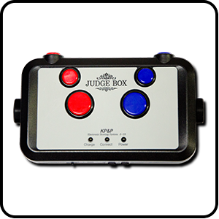
Electronic Scoring – PSS Controller Box
4 Point – Turning head kick. Simultaneously press both 3 point and technical point buttons.
3 Point – Non-turning head Kick or 3 Point turning body kick
1 Technical Point
KP&P equipment scores 2 points for a body kick
1 Point - Punch
Electronic Scoring – Correcting Scoring Errors
If a judge presses the wrong button, he/she should immediately press the correct button.
If the judge sees that the error resulted in no-score, he/she should stand up immediately.
When one judge stands, all should stand.
When the Referee calls for a conference, it should be short, no involved discussions. Referee should not influence the judges.

Slide 82
Knock Down
A knock down shall be declared when a legitimate attack is scored and any of the following criteria are met:
When any part of the body other than the sole of the foot touches the floor due to the force of the opponent’s scored attack
When a contestant is staggered, showing no intention or ability to pursue the match following the opponent’s scored attack
The Referee determines that the contest cannot continue as the result of any scoring technique

Slide 83
Procedure In The Event Of a Knock Down
When a knock down occurs and the referee deems that an eight-count is warranted, the following measures shall be taken:
  The referee shall keep the attacker away from the downed contestant by declaration of Kal-yeo (break).
  The referee shall begin to count aloud from Ha-nah (one) up to Yeo-dul (Yeol (ten) if competitor does not recover by Yeo-dul) at one-second intervals towards the downed contestant, making hand signals indicating the passage of time.
  The count shall be continued even after the end of the round or the expiration of the match time.
If the referee begins an eight-count for a legal body kick:
  When using PSS, but points are not scored by PSS, the referee will continue the count. If the competitor has recovered and assumed a fighting posture by Yeo-dul, the match will continue on the referees Kye-sok command. If the competitor has not recovered by Yeo-dul, the referee will continue the count to Yeol and the match will be over.
  When not using PSS, if points were not scored, the judges should stand to indicate that points should have been scored
  If the player is able to continue by the count of eight (“Yeo-dul”), the referee declares Shi-gan and confers with judges to determine that points should have been awarded

Slide 84
Procedure In The Event Of a Knock Down (continued)
If the referee begins an eight-count for a legal head kick:
  When using e-head gear, but points are not scored by the e-head gear, the referee will continue the count. If the competitor has recovered and assumed a fighting posture by Yeo-dul, the match will continue on the referees Kye-sok command. If the competitor has not recovered by Yeo-dul, the referee will continue the count to Yeol and the match will be over.
  When not using e-head gear, if points were not scored, the judges should stand to indicate that points should have been scored
  If the player is able to continue by the count of eight (“Yeo-dul”), the referee declares Shi-gan and confers with judges to determine that points should have been awarded

Slide 85
Procedure in the event of a Knock Down (continued)
If the downed contestant stands up during the referee’s count and demonstrates a desire to continue the fight, the referee shall continue the count up to Yeo-dul (eight) for recovery of the downed contestant.
The referee shall then determine if the contestant is recovered and can safely continue.
The Referee will continue the contest by declaration of Kye-sok (continue).
The primary purpose of counting is to protect the contestant. If the Referee feels there is a need to evaluate the downed competitor, he/she will begin an 8-count.
Once an 8-count is started, the Referee must continue the count to Yeo-dul, even if the downed contestant stands up during the referee’s count and desires to continue the fight.
If the downed competitor assumes a fighting stance, the Referee may still declare the contest over if he/she determines the contestant is incapable of resuming the match.

Slide 86
Procedure in the event of a Knock Down(continued)
Continuing the Match
A contestant expresses the will to continue the match by gesturing several times in a fighting position with the clenched fists. If the contestant cannot display this gesture by the count of Yeo-dul, the referee must declare the other contestant winner after first counting
  A-hop and Yeol. Expressing the will to continue after the count of Yeo-dul cannot be considered valid.
Continuing the Match with Medical Time
When the contestant recovers before the count of Yeo-dul and expresses the will to resume and the referee can clearly discern the condition of the contestant yet resumption is hampered by the requirement of medical treatment or clean up, the referee will declare Shi-Gan to allow medical to administer treatment and/or cleanup.

Slide 87
Procedures to be followed After a Ten Count
Both Competitors Receive a Ten Count
When the Referee judges that a contestant(s) is unable to continue, he/she may decide the winner either without counting or during the counting.
In case both contestants are knocked down, the referee shall continue counting as long as one of the contestants has not sufficiently recovered.
When both contestants fail to recover by the count of Yeol, the winner shall be decided upon the match score before the occurrence of knock down.
Medical Clearance
Any contestant suffering a knock-out as the result of a blow to the head or any serious injury to any part of the body, will not be allowed to spar for 30 days.
Before entering a new sparring contest after 30 days, the contestant must be examined by a medical doctor who must certify that the contestant is recovered and able to compete.

Slide 88
Tie Score at the End of the Match
Golden Point (Overtime)
Golden Point - Using PSS
If the score is tied at the end of match time, the competitors will go into a Golden Point round. The scoreboard resets to zero. However the total amount of points are recorded on the paperwork.
The referee will signal the competitors to their coaches as in the previous rounds.
The first point scored or first two (2) penalty points awarded in the Golden Point round determines winner.
If the winner is not determined through the Golden Point round, the method of deciding the winner is determined based whether the competitors are using PSS or non-PSS chest protectors.
If using a PSS, the winner is determined by the PSS using the following criteria:
  The first criteria will be the player who makes the most contact to the other player's chest protector in the Golden Point round as scored by PSS (the hit level does not matter).
  If the score is still tied (same number of hits), the player who receives the least gam-jeoms from all rounds will be the winner.
  If the first two criteria are tied, the Referee and Corner Judges will use the normal superiority method based on the Golden Point round to determine the winner. This process is called Woo-Si-Girok.
Notes:
December 2004
88

Slide 89
Tie Score at the End of the Match
Competitors Using PSS
If a point scored from an illegal act and the referee invalidates the point, giving a gam-jeom, the TL must also eliminate the missed hit from the computer at the time of the penalty.
Notes:
December 2004
89

Slide 90
Tie Score at the End of the Match
Competitors Using PSS
When competitors are using PSS and are fighting the Golden Point round, in the event that one athlete delivers a successful head kick right before the opponent’s body kick but the body kick was registered through the PSS, the coach of the athlete who delivered the head kick or any of the judges may request a challenge for the head kick. The Referee will consult with the Corner Judges. If it is determined that the head kick was valid and performed before the body kick, the Referee shall invalidate the point scored by body kick, then declare 3 or 4 points for the head kick, and declare the one who delivered head kick as winner. When using e-headgear only face kicks can be challenged.
Notes:
December 2004
90

Slide 91
Tie Score at the End of the Match
Competitors using Non-PSS
Woo-Si-Girok
If the winner is not determined through the Golden Point round, the judges and referee will decide the winner using the rules of superiority based on the Golden Point round only. (Woo-Si-Girok is announced to indicate this process).
The Rules of Superiority are as the competitor who has shown the most initiative, which is defined as:
  Technical dominance of the opponent through aggressive match management
  The greater number of techniques executed
  use of more advanced techniques, both in difficulty and complexity
  Display of better competition manner
Both competitors will be called back to their marks.
With the competitors standing on their marks, the Referee will raise both hands to his/her chest and announce Woo-Si-Girok.
The Judges will immediately cast their vote using the Superiority Card for Chung or Hung as the superior player. The referee does not vote for the winner.
The competitors will remove their headgear, the referee will bow them out and award the winner by declaring “Chung Sung” or “Hong Sung”.
Notes:
December 2004
91

Slide 92
Procedure for Suspending the Match
Non-Injury
Injury
The following procedures are used to stop the match for non-injury time, such as equipment adjustment, removal of foreign objects from competition floor, etc. or for an injury that is not defined as a knockdown such as accidental falling or an injury from a prohibited act.
To suspend a match for non-injury the Referee shall:
  Declare Kal-yeo to stop the competitor action.
  The timekeeper will suspend the time.
To suspend a match for injury the Referee shall:
  Declare Kal-yeo to stop the competitor action
  The timekeeper will suspend match time and start a Kye-she injury time on the Referee’s command. (Kye-shi time shall not exceed one-minute.)
  Allow the injured competitor to receive first aid (within one minute)
  The Kye-shi clock must be stopped before one minute if the match can continue. This is done by the Referee issuing Shi-gan.
Notes:
December 2004
92

Slide 93
Procedure for Suspending the Match
If Injured Competitor CAN Continue
If Injured Competitor CANNOT Continue
If the player can continue, but medical requires more time for cleanup or continued aid, the Kye-shi clock is stopped with Shi-gan.
The medic must indicate prior to the lapsing of the Kye-shi clock that the player will be able to continue.
The Shi-gan time must be reasonable.
Declare the injured competitor the loser if the injury was the result of an act that did not result in a penalty for the attacking competitor.
Declare the injured competitor the winner if the injury was the result of a prohibited act that was assessed a Gam-jeom penalty.
Declare a winner based on the score before the injury if both contestants are injured and cannot continue.
The referee may consult with the TL to make a decision.
Notes:
December 2004
93

Slide 94
Pain is not an Injury
So just how are Referees supposed to handle these situations.
We know that if a competitor falls to the floor, they get a penalty. We know that if a competitor falls to the floor and there is a bone protruding from their finger or arm or their leg is bent in a way it shouldn’t bend, that is most definitely an injury and it needs medical attention.
But what about those groin kicks! Do we give a kye-shi? Do we do the stand up three times thing, then give a gam-jeom if he takes too long to get up? Do we just ignore it because they guy really looks like he is in terrible pain? But pain is not an injury, so we have to do something!
Notes:
December 2004
94

Slide 95
Pain is not an Injury
Here are some scenarios
If a groin kick is intentional: kal-yeo, kye-shi, and gam-jeom to kicker.
If a groin kick is unintentional(accidental during exchange): kal-yeo, and competitor must continue (3-second rule). No penalty if the competitor resumes the match.
Unintentional kick on leg or shin, hit on the arm, or falling for any other reason: three second rule and gam-jeom to fallen competitor.
Kick to the body and no points scored (Referee doesn’t begin 8-count): three second rule and gam-jeom to fallen competitor.
Both competitors fall for any reason: No penalty and wave hand signal.
Blue falls because of Red’s prohibited act: Red gets gam-jeom.
Notes:
December 2004
95

Slide 96

Prohibited Acts
The Referee shall declare all penalties
In the case of multiple penalties being committed by one player simultaneously, only one penalty is assessed
A Gam-jeom is counted as one (1) point penalty. All Gam-jeoms are recorded by adding one point to the opponent’s score
The timekeeper will stop the match clock for all gam-jeon penalties
Notes:
December 2004
96

Slide 97
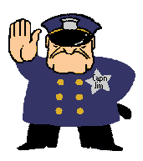
Prohibited Acts
All infractions Gam-Jeoms penalties
Notes:
December 2004
97

Slide 98
Prohibited Acts
Joo-eui(Verbal Warning Only)
Joo-euis are only given to lower belts as a training tool. They are not given to advanced Black Belts.
Joo-euis are given at the discretion of the Referee.
Joo-euis are warnings only and are not noted on the scoreboard. They are not mandatory and should be used sparingly in upper belt divisions.
Only one Joo-eui per infraction per round per competitor can be given.
Once a Joo-eui has been awarded in a round, the next infraction for the same act must be given a Gam-jeom.
Joo-euis are given verbally. There is no hand signal.
Notes:
December 2004
98

Slide 99
Penalties
1. Crossing the Boundary Line
  Both feet must be out for penalty to be given
  Intentionally leaving the competition area will result in a penalty
  Being kicked out by opposing player will result in a penalty
  If the competitor is pushed out of competition area, no infraction to the player forced out. A pushing penalty will be given to the opposing competitor
  Both players can get a gam-jeom if one player follows the other player out of bounds before kal-yeo.
Notes:
December 2004
99

Slide 100
Penalties
2. Avoiding or Delaying the Match
This act involves stalling with no intention of attacking. A contestant who displays a non-engaging style shall be given a penalty.
  If both players remain inactive for five seconds, the Referee will issue a warning to both competitors by bringing both fists together twice (at chest level) while issuing the command “fight”.
  If there is no activity from both for ten more seconds after the command, a gam-jeom will be given both or to the competitor who moved backwards from the original position ten seconds after the command was given.
Turning the back to avoid the opponent’s attack should be punished as it expresses the lack of a spirit of fair play and may cause serious injury. The same penalty should be given for evading the opponent’s attack by bending below waist level or crouching.
Notes:
December 2004
100

Slide 101
Penalties
2. Avoiding or Delaying the Match (continued)
Pretending injury means exaggerating injury or indicating pain in a body part not subjected to a blow for the purpose of demonstrating the opponent’s actions as a violation, and also exaggerating pain for the purpose of elapsing the match time. In this case, the referee shall give a gam-jeom penalty.
Retreating from the technical engagement only to avoid the opponent’s attack and to run out the clock, shall result in a gam-jeom penalty for the passive contestant.
Gam-jeom will be given to an athlete who asks the referee to stop the contest in order to adjust protective equipment.
Notes:
December 2004
101

Slide 102
Penalties
3. Falling Down
Penalty
No Penalty
  If a kick is thrown, but no contact is made, a fall will result in a penalty
  If a competitor touches the floor with the hand to aide in the execution of a kick
  If the competitor slips on the mat
  If both competitors fall
  If a competitor falls due to the opponent’s prohibited act

Slide 103
Penalties
4. Grabbing or Pushing the Opponent
  Grabbing any part of the opponent’s sleeve, uniform or protective equipment with the hands.
  Grabbing the foot or leg or hooking either one on top of the forearm.
  A little grabbing is allowed as long as:
    The arm(s)do no wrap around the opponent’s body
    The arms are not squeezing the opponent’s body
    The arms are not moving the opponent around
    The arms are not controlling the opponent
  Pushing acts include pushing the opponent out of the boundary line or pushing the opponent in a way that prevents a kicking motion or any normal execution of attacking movement.
Notes:
December 2004
103

Slide 104
Penalties
5. Attacking Below the Waist
This penalty is given for any kick below the waist
This penalty applies to strong kicking or stamping actions to any part of the thigh, knee, or shin for the purpose of interfering with the opponent’s technique
This penalty is not given when an attack is caused by the recipient in the course of an exchange of techniques
6. Lifting the leg or knee
Lifting the knee to block the opponent’s kicking attack
Lifting the leg to impede the opponent’s attacking movement without execution of any kicking movements
Lifting the leg and kicking in the air above the waist for more than three (3) seconds
Lifting the leg or cut kick motion shall not be penalized when followed by the execution of a kicking or punching technique in combination motion.
Notes:
December 2004
104

Slide 105
Penalties
7.Butting or Attacking with the Knee
Penalty
No Penalty
Any intentional head butting or attacking with the knee when in close proximity to the opponent.
When contact with the knee happens when the opponent rushes in abruptly at the moment a kick is being executed
When contact with the knee occurs as a result of a discrepancy in distance in attacking
8. Hitting the Opponents Head with the Shoulder/Hand
Penalty
No Penalty
Hitting the opponent’s head with the hand (fist), wrist, arm or elbow. This includes an intentional shoulder shrug to the head area.
Unavoidable actions due to the opponent’s carelessness such as excessively lowering the head or carelessly turn the body
Notes:
December 2004
105

Slide 106
Penalties
9. Attacking and Making Contact with the Opponent after Kal-Yeo
Attack must result in actual contact to the opponent’s body
If the attacking motion started before the kal-yeo command, the attack shall not be penalized
The timing of kal-yeo shall be defined as the moment that the referee’s kal-yeo hand signal was completed (with fully extended arm); and the start of the attack shall be defined as the moment that the attacking foot is fully off the floor
If an attack after kal-yeo did not land on the opponent’s body but appeared deliberate and malicious the referee may penalize the behavior with a gam-jeom (misconduct)
10. Attacking and Making Contact to a Fallen Opponent
This action is dangerous due to the high probability of injury to the opponent. The danger arises from the following:
  The fallen opponent is in an immediate defenseless state
  The impact of any technique which strikes a fallen contestant will be greater due to the contestant’s position
Notes:
December 2004
106

Slide 107
Penalties
11. Misconduct on the part of a coach or a contestant
Not complying with a Referee’s command or ruling
Inappropriate protesting or criticizing of officials’ decisions
Leaving the designated coach’s seat or standing up
Loud coaching during the rounds
Provoking or insulting officials, opposing contestant, coach, or spectators
Any other undesirable behavior or unsportsmanlike conduct from a contestant or coach
Notes:
December 2004
107

Slide 108
Youth
Safety
Rules
Notes:
108

Slide 109
Youth Safety Rules
Youth safety rules apply to youths 5–14 year of age all belts and 15–17 year old colored belts.
Youth safety rules only affect the amount of contact used in head attacks. All other Olympic sparring rules apply to all youth and adults.
How Hard is Too Hard?
There are three criteria to determine if the kick is too hard.
  Did the head move as a result of the force of the kick?
  Did the kick make a sound when it hit?
  Did the kick leave a mark on the face?
Notes:
109

Slide 110
Youth Safety Rules
A competitor who executes a controlled light contact technique to the head will receive three or four points
A competitor who executes a kick to the head which results in a injury will receive a gam-jeom deduction.
A competitor who executes a kick to the head which does not cause injury, but in the opinion of the referee is excessive, will receive a gam-jeom deduction.
The competitor who executes a kick to the head which results in the inability of the opponent to continue sparring because of the injury, shall be disqualified.
Notes:
110

Slide 111
Youth Safety Rules
12 - 14 year old Cadets fighting at Team Trials will use the same contact rules as the 15 – 17 year old Juniors
Notes:
111

Slide 112
Special Needs Divisions
Modified Rules
At this time, special needs divisions are limited to forms and point sparring
All special needs forms are judged using the scored method
All local qualifiers are encouraged to include special needs divisions at their tournaments, however special needs competitors are not required to qualify to compete at national events.
Forms Competition Levels and Scoring
Besides age, belt and gender, special needs forms divisions will also be divided into the following categories.
  Level 1: Basic skills (Perform blocking, striking and kicking techniques with direction from an instructor
  Level 2: Perform pattern with assistance from an instructor
  Level 3: Perform pattern on own
Merit will be awarded on the basis of SPIRIT, focus, technique, power, rhythm, grace and beauty listed in order of importance.

Slide 113
Special Needs Divisions
Point Sparring Mandatory and Equipment Modifications
Foot protectors are not required for Category Level 3 (Wheel Chair)
Sport wheel chair, basketball style with wheelie bar (Category level 3)
Point Sparring Competition Levels
Besides age, belt and gender, special needs point sparring divisions will also be divided into the following categories:
  Level 1: Limited mobility of arms and/or legs (cannot kick above waist, cannot extend arms fully for hand techniques) or lower level of cognitive skills.
  Level 2: Full mobility of arms and legs (can kick above waist and can extend arms fully for hand techniques) or higher level of cognitive skills
  Level 3: Wheelchair

Slide 114
Special Needs Divisions
Point Sparring Scoring – Level 1 (No Head Contact Allowed)
Competitors have limited mobility
One point shall be awarded for any valid hand technique executed to the legal body area within 1 inch or light contact and good technique
Two points shall be awarded for any valid foot technique executed to the legal body area within 1 inch or light contact and good technique. Points may be awarded for intent based on the physical limitations of the competitor to raise the foot.
Point Sparring Scoring – Level 2 (No Head Contact Allowed)
Competitors have full mobility
One point shall be awarded for any valid hand technique executed to the legal body area with light contact and good technique
Two points shall be awarded for any valid foot technique executed to the legal body area with light contact and good technique.
Point Sparring Scoring – Level 3 (Head Contact Allowed)
Competitors compete from a wheelchair
One point shall be awarded for any valid hand technique executed to the legal head area with light contact and good technique
Two points shall be awarded for any valid hand technique executed to the legal body area with light contact and good technique.

Slide 115
Junior Olympic Games
Junior Olympic Games competition is open to all belts from ages 5-24. (There is no age limit on Special Needs athletes)
Participation at a local or regional licensed qualifying event is the only eligibility requirement to go to the J.O.s.
J.O.s is held at a different location around the country every year. The Games have more than 15,000 athletes competing in various sports.
The 2018 Games will be held in Des Moines, IA.
Notes:
115

Slide 116
Junior Olympic Games
J.O. Games competition offers the following events
        Individual Traditional Forms
        Creative Forms
        Creative Musical Forms
        Weapons Forms
        Musical Weapons Forms
        Self-Defense
        Creative Board Breaking
        Speed Board Breaking
        Flying/Jumping Board Breaking
        Power Hand Board Breaking
        Power Foot Board Breaking
        Repetitive Speed Foot Board Breaking
        Repetitive Speed Hand Board Breaking
        Padded Weapons Sparring
        Team Forms
        Demo Team Competition
Notes:
116

Slide 117
Junior Olympic Games
J.O. Games Competition Rules
For more information on the rules governing each type of Games competition refer to the J.O. Games section of the 2018 Handbook.
Notes:
117

Slide 118
The End

